Slide 2
Creating Mission Models using SysML and Cameo Systems Modeler
John K. DeHart
AVIAN Inc.

Slide 3
Creating Mission Models using SysML and Cameo Systems Modeler
John K. DeHart
jdehart@avian.com

Slide 4
Introductions
Introduce the topic of mission modeling using Cameo Systems Modeler
Outline the presentation agenda

Slide 5
SysML Models and Containment Trees
Explain that a SysML model is more than just diagrams
Emphasize the importance of the containment tree, where diagrams are just views of the model

Slide 6
Defining Purpose, Objectives, Goals, and Scope
Stress the need for clear purpose, objectives, goals, and scope
Discuss how models inform documentation, simulation models, and other processes

Slide 7
Creating Informed and Informing Models
Explain the importance of building models that are informed by other models to avoid creating malformed models
SE provides Mission Critical Information

Slide 8
Thinking About Model Structure
Discuss how to approach creating mission models, decomposing nouns and verbs into structure and function in SysML
Emphasize the desired outcomes, such as defining missions, analyzing, and simulating

Slide 9
Model Information and Informed Outputs
Address the structure of the model and the information it needs to inform other processes

Slide 10
Treeview and Model Instances
Highlight the relationship between the treeview and model instances
Explain the benefits of using treeview to create multiple instances quickly

Slide 11
Using Instances to Inform
Discuss different ways to export models (XML, Teamwork Cloud API)
Explain the benefits of using the API and its compatibility with SysMLv2

Slide 12
Demo - Building a Simple Mission Model
Demonstrate building a mission model with scenario, vignette, packages, and performers
Use a remote medical support system as an example

Slide 13
Demo - Creating Instance Tables
Show how to create instance tables for drones, hospitals, and medicine

Slide 14
Demo - Middleware and API
Demonstrate accessing instances through the API and updating attributes
Discuss the flexibility and CRUD operations the API offers

Slide 15
Demo - Simulation Integration
Export the JSON file and demonstrate integration with Netlogo
Show how updating the instance affects the Netlogo simulation

Slide 16
Setup Learning on VTOLFoS
eQ incident
And new methods

Slide 17
Summary and Q&A
Summarize the key points of the presentation
Invite questions and open the floor for discussion

Slide 18
Thank you!

Slide 19
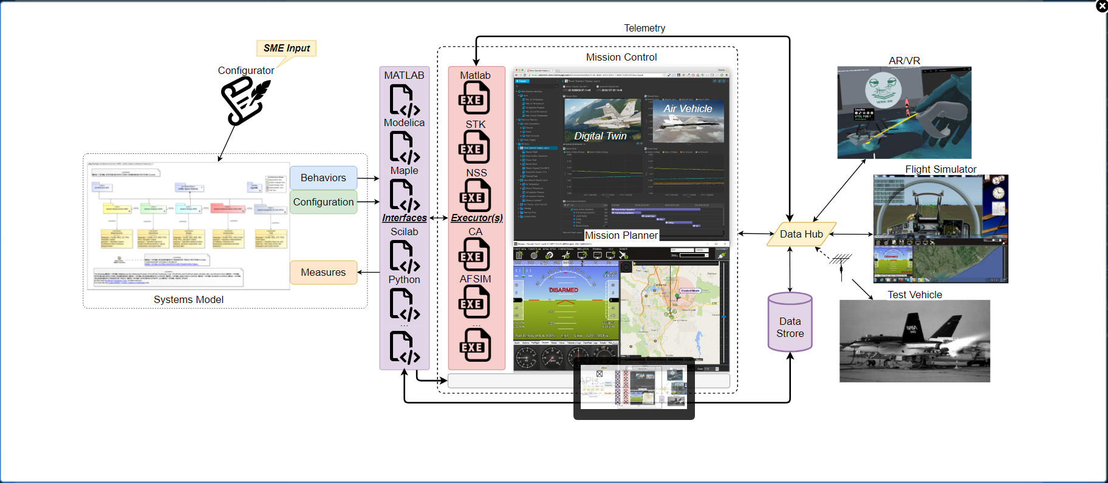

Slide 20
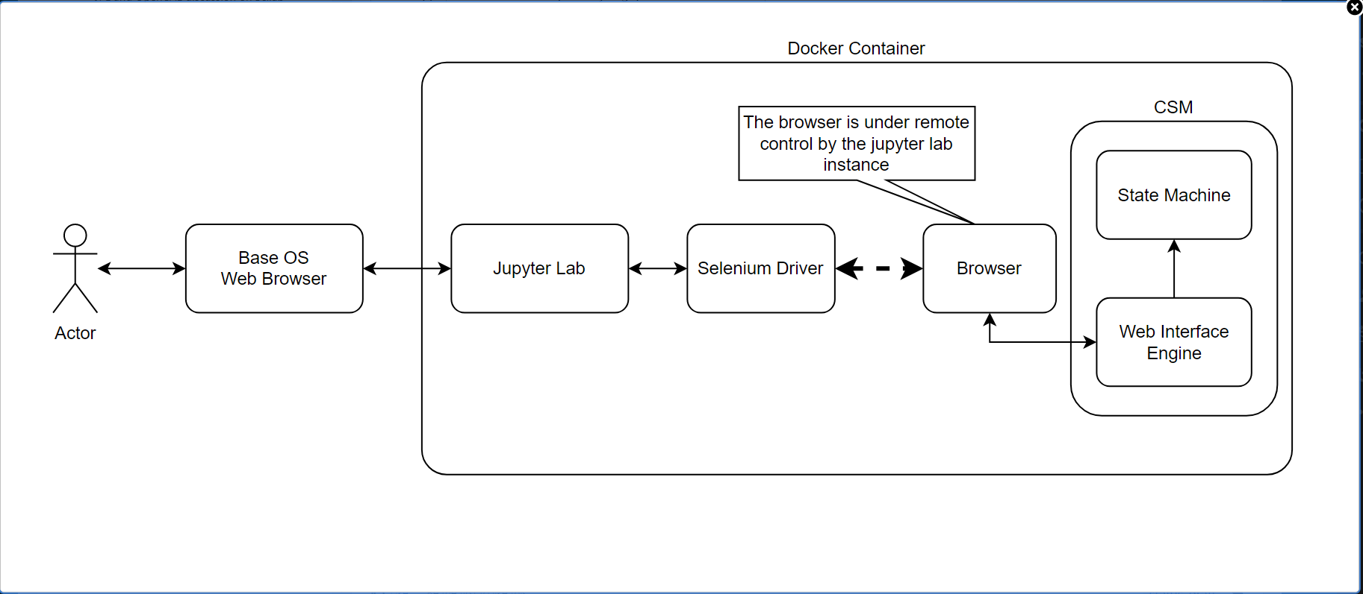

Slide 21
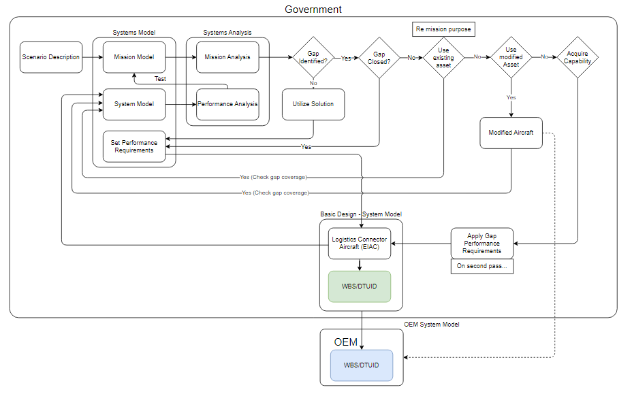

Slide 22
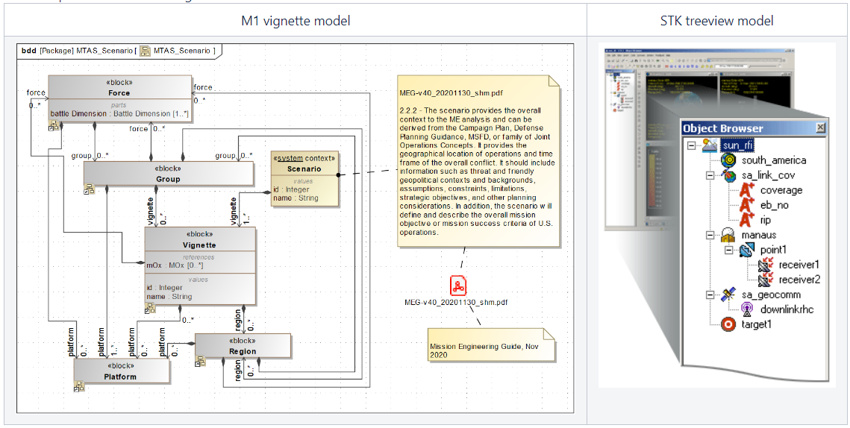
Notes:
MTAS vignette model - John K. DeHart - USN/USMC VTOL FoS Program (navy.mil)

